Slide 1
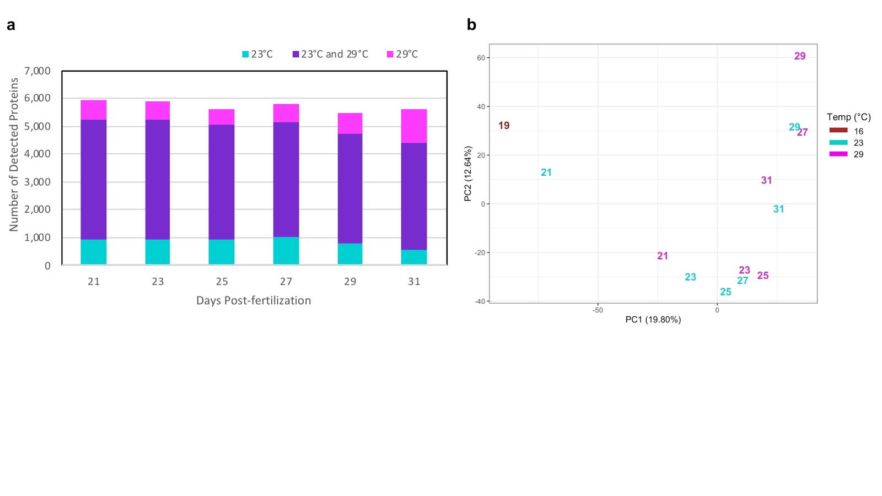




A
21
23
25
27
29
31
Larva
19
29°C
embryo
23°C
fertilization
16°C
24 – 48 hours
a few – 72 hours
adult
competent pediveliger larvae
settlement & metamorphosis
Post-metamorphosis
Juvenile
B
C

Slide 2
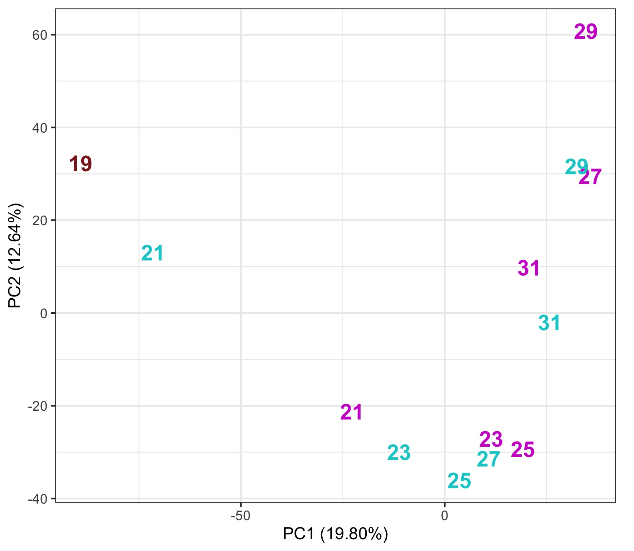
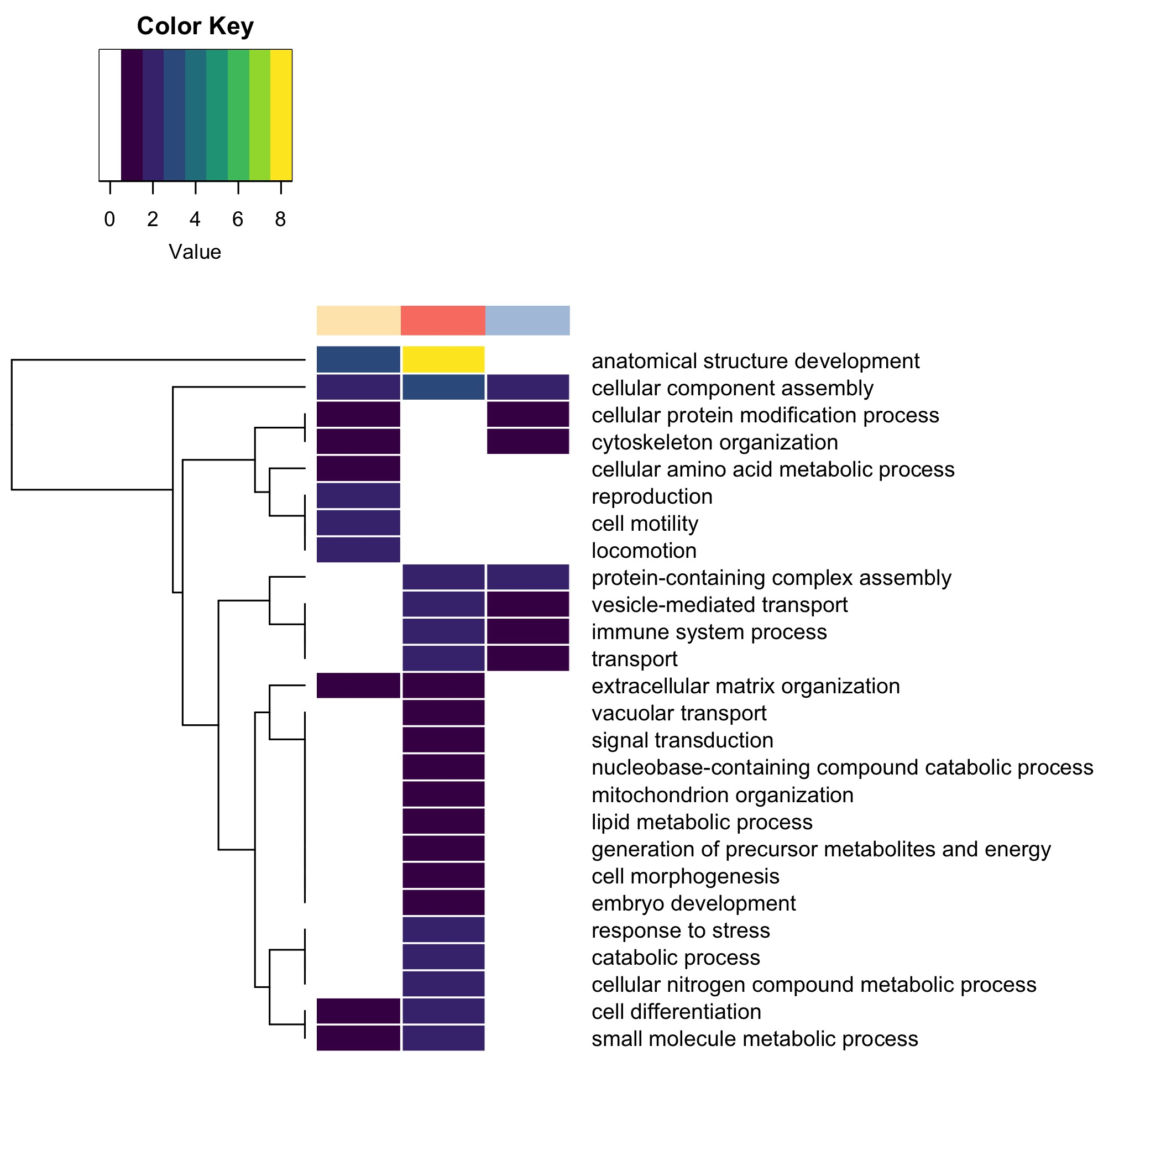
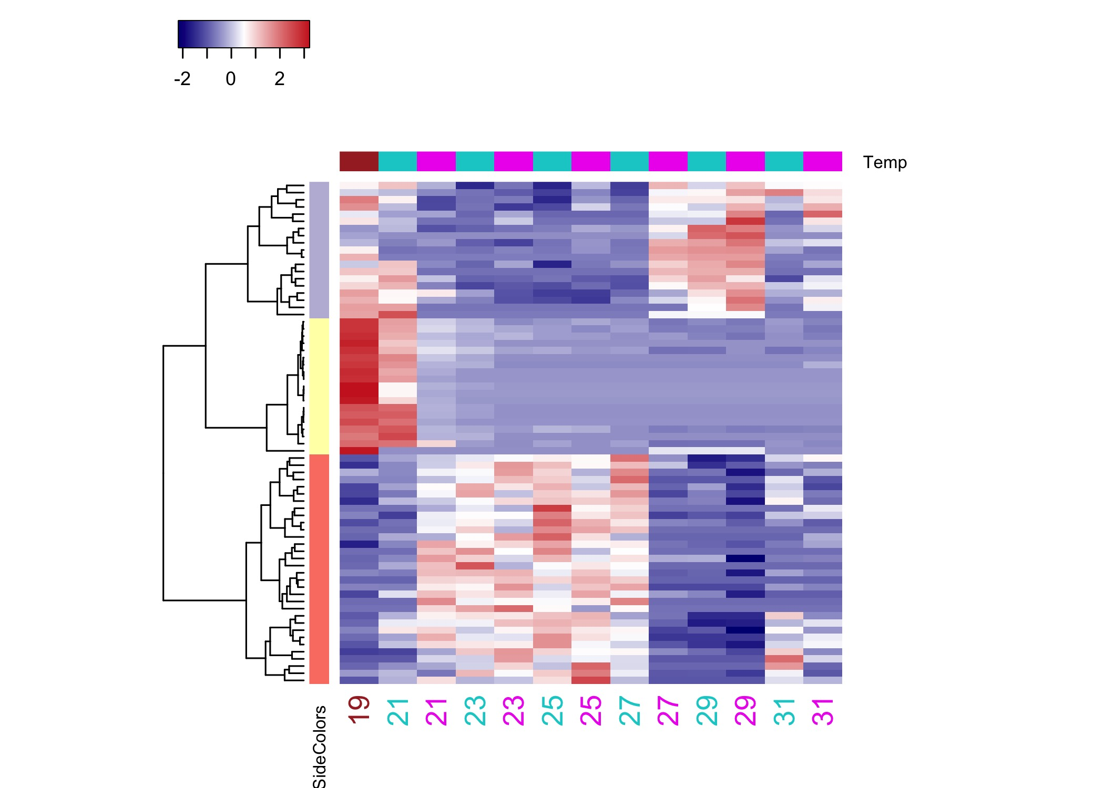
A
C
Number of enriched GO terms
clade
pale yellow
salmon
pale purple
B
dpf
NSAF value
autoscaled by row

Slide 3
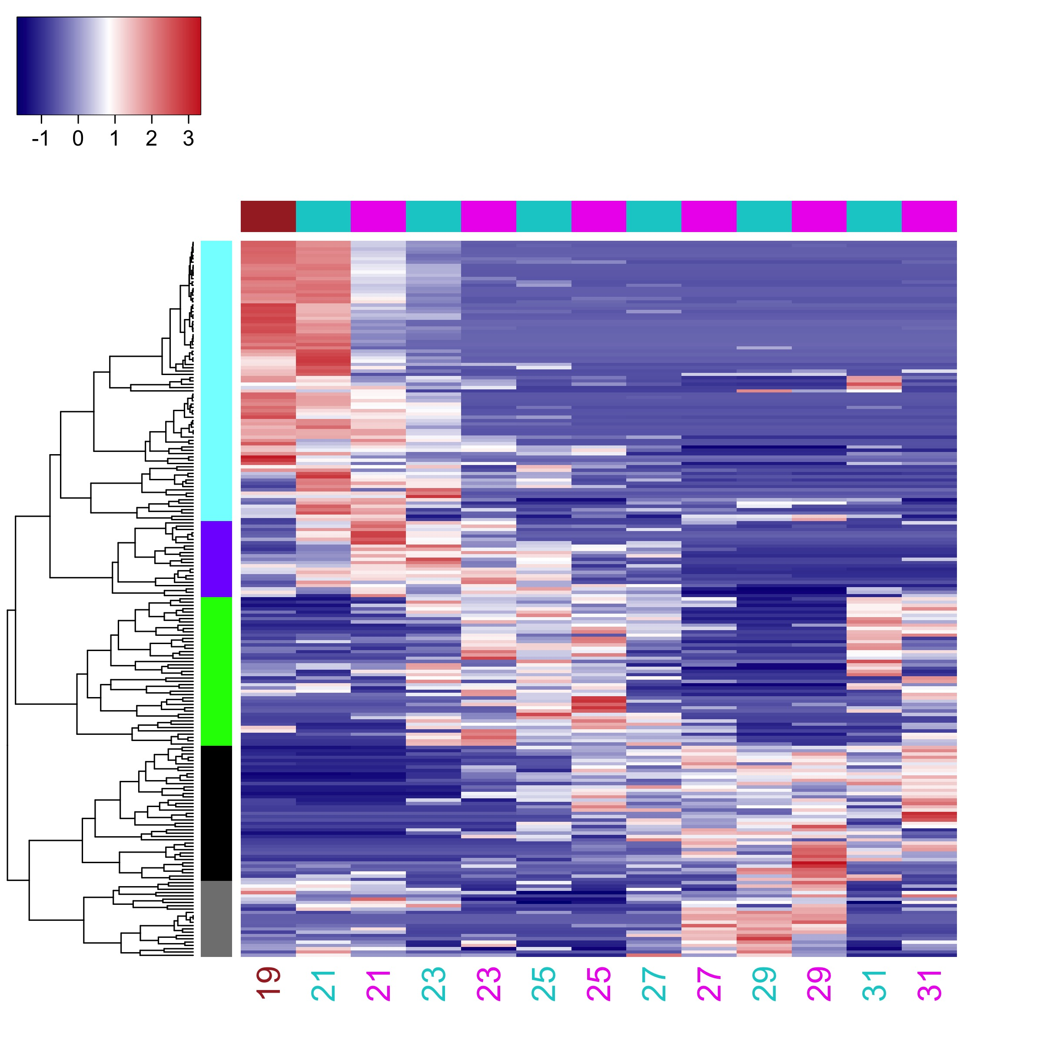
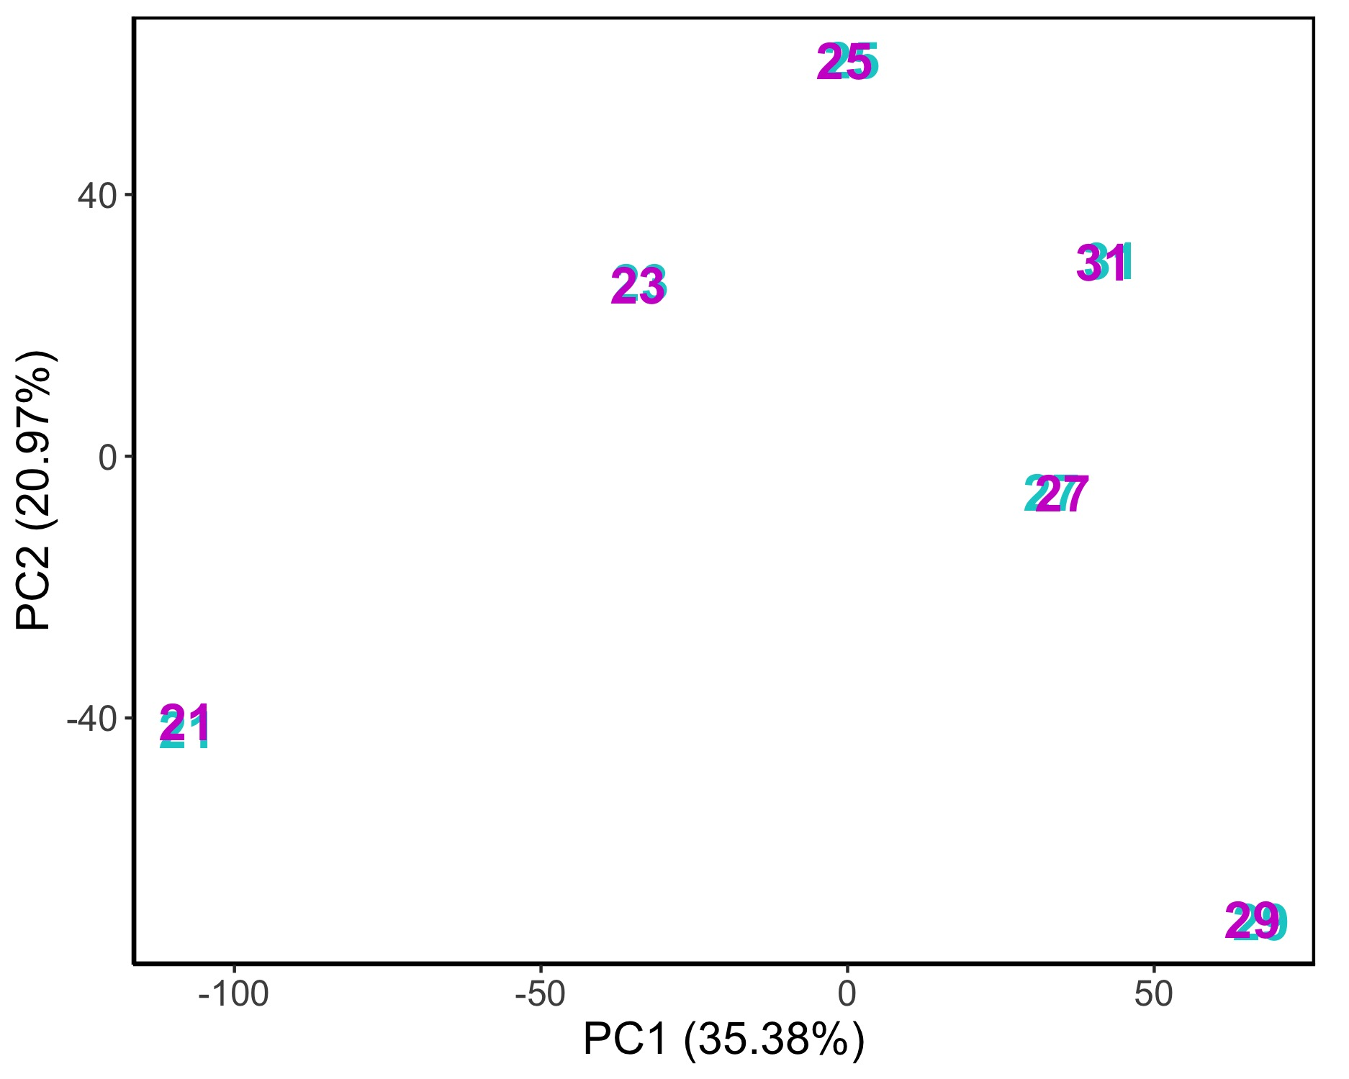
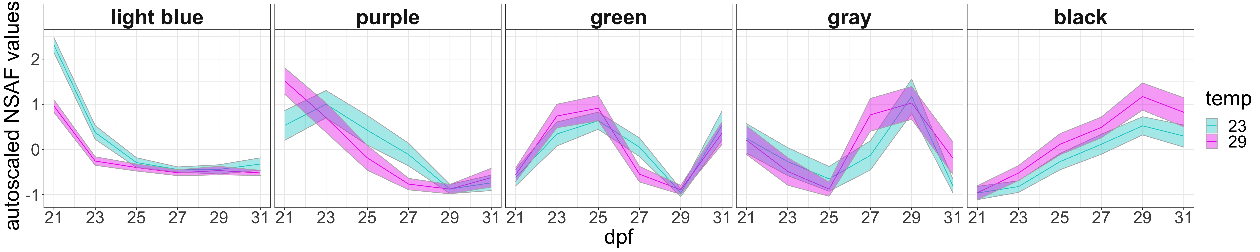
A
B
dpf
Temp (°C)
NSAF value
autoscaled by row
C
black

Slide 4
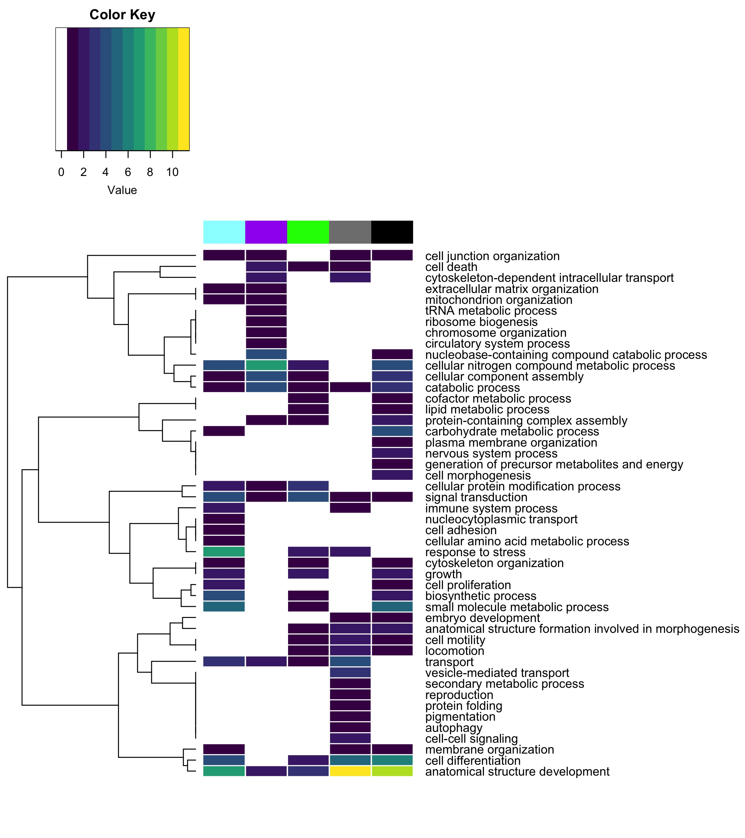
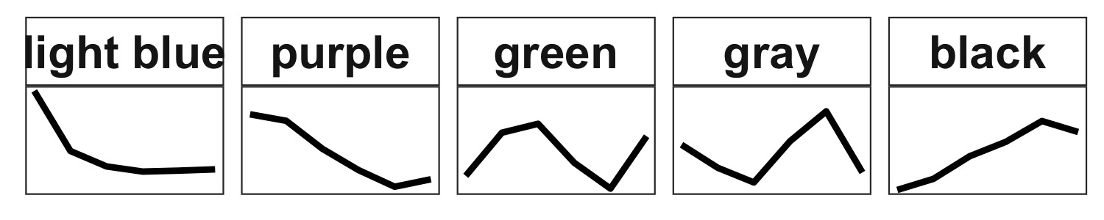
Number of enriched GO terms
clade
clade

Slide 5
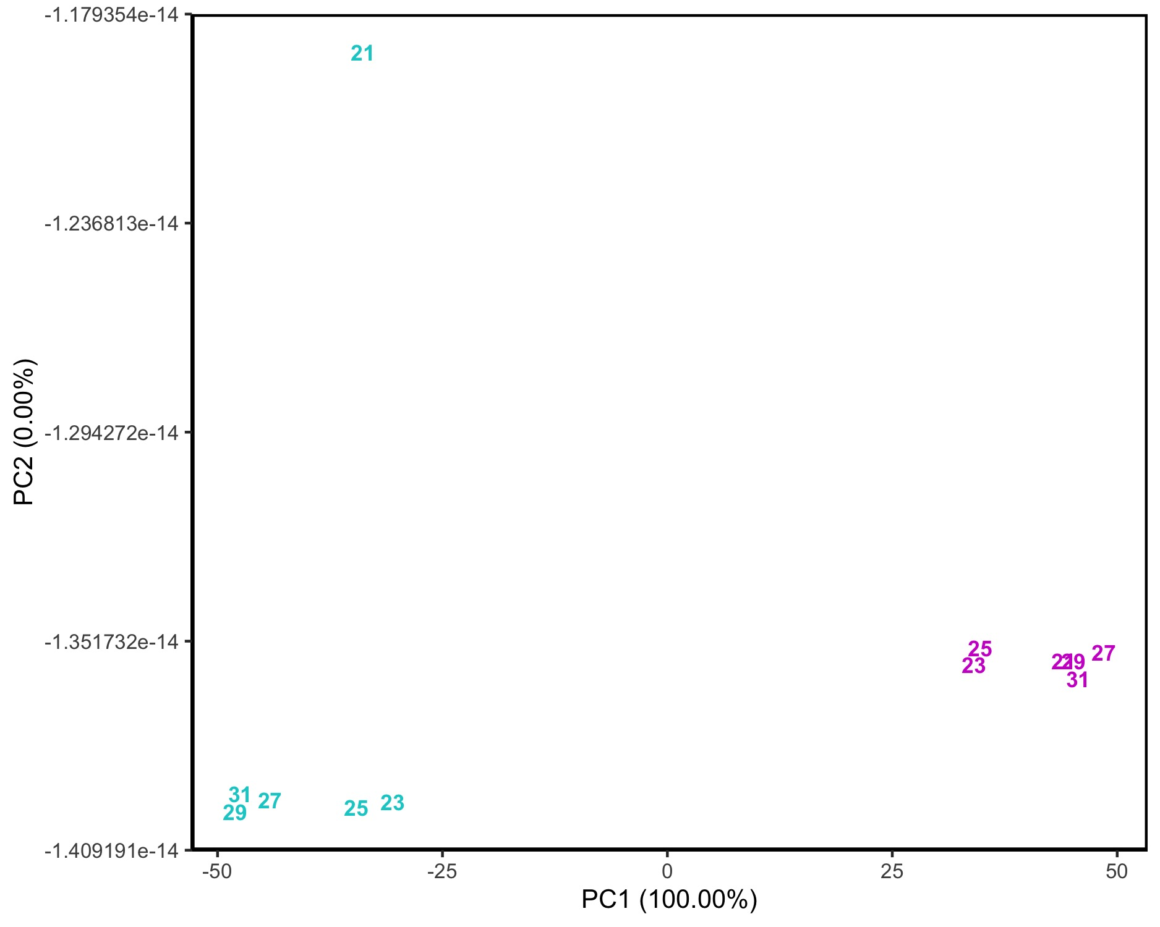
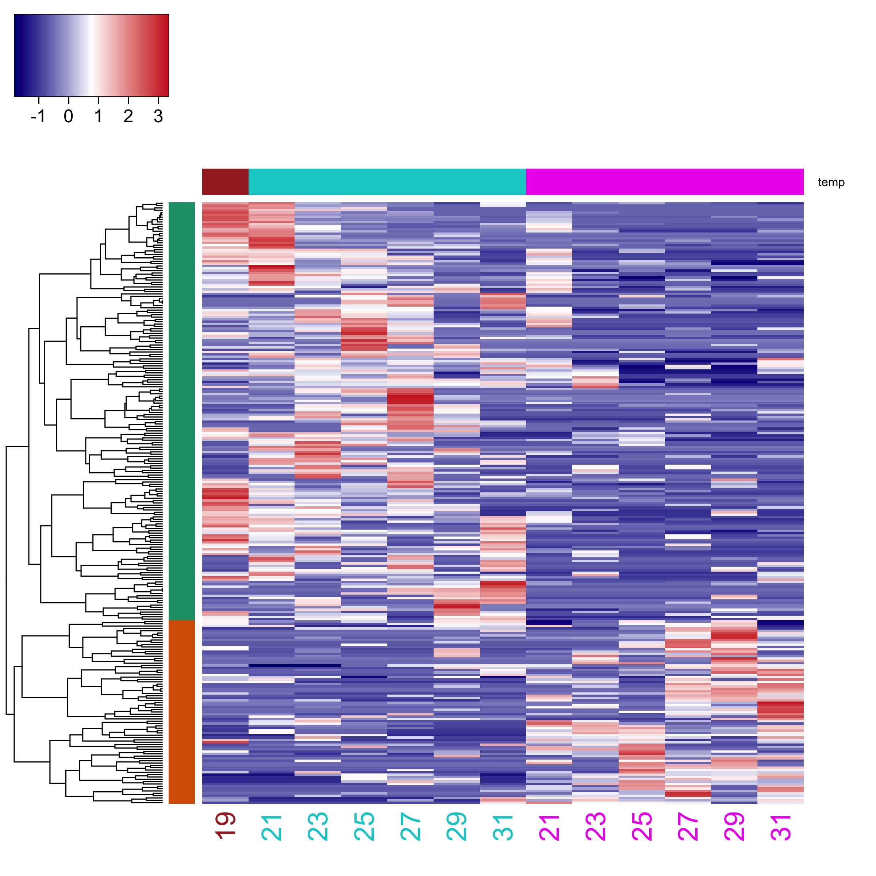
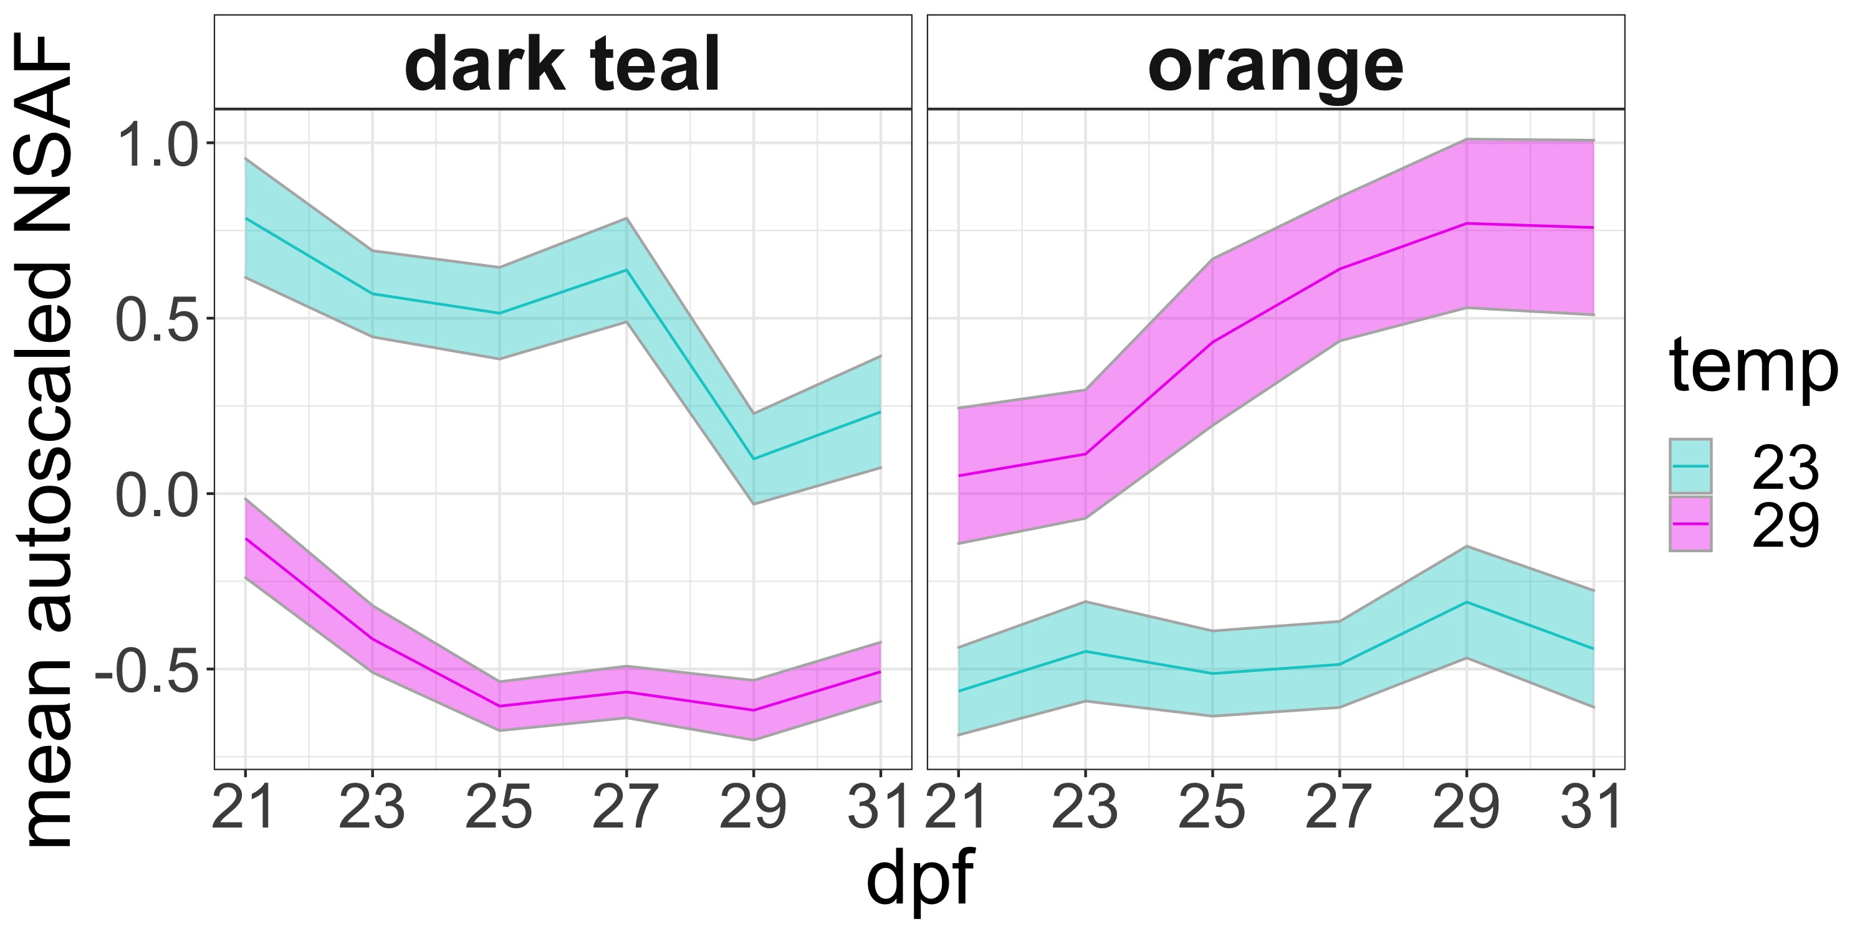
A
B
Temp (°C)
dpf
NSAF value
autoscaled by row
C

Slide 6
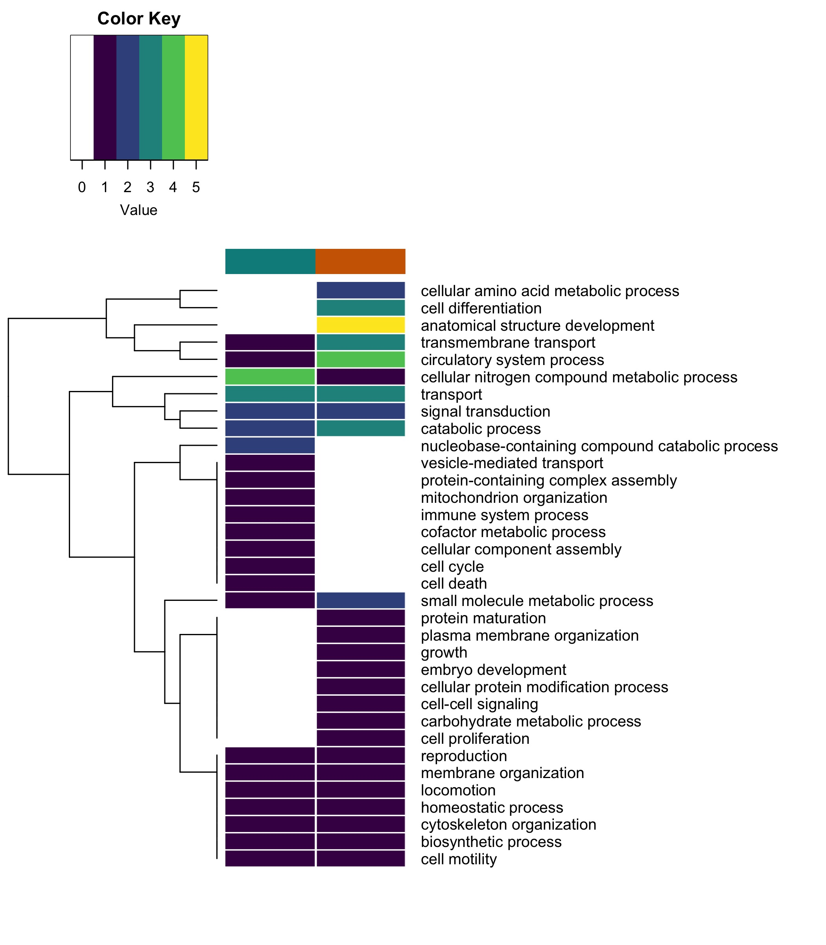
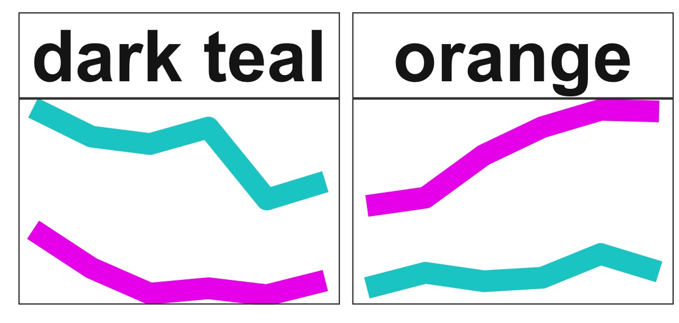
Number of enriched GO terms
clade

Slide 8
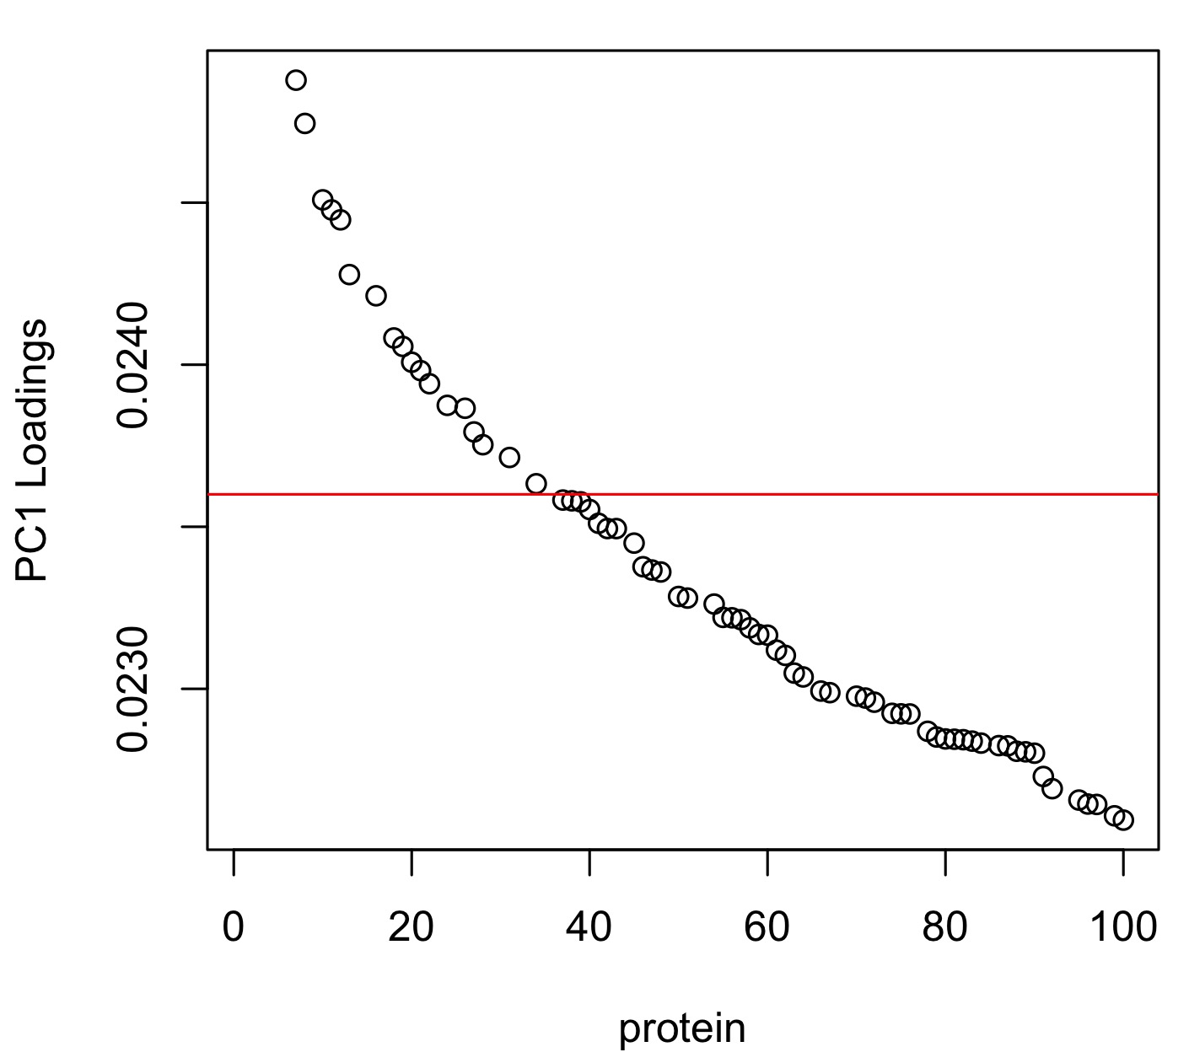
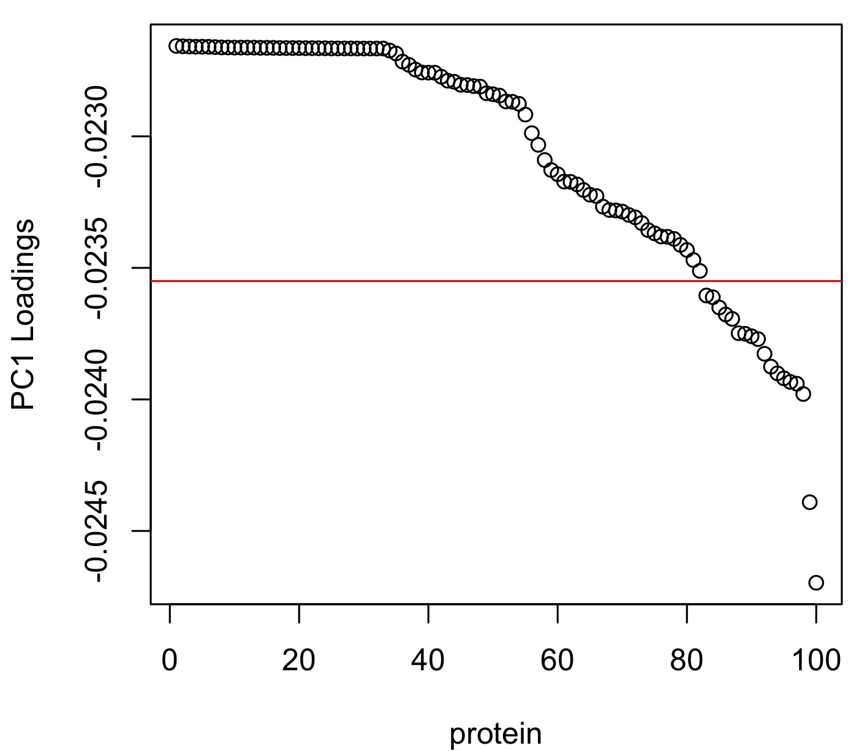
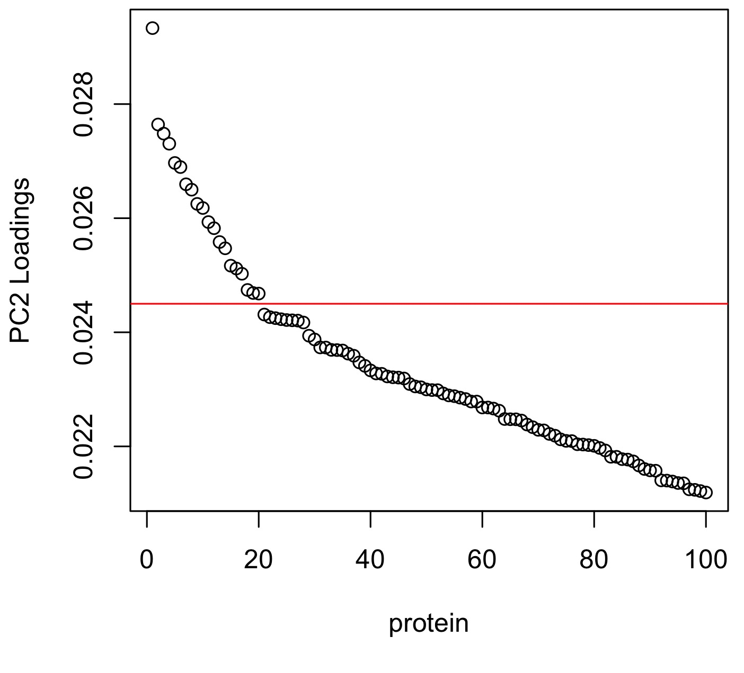
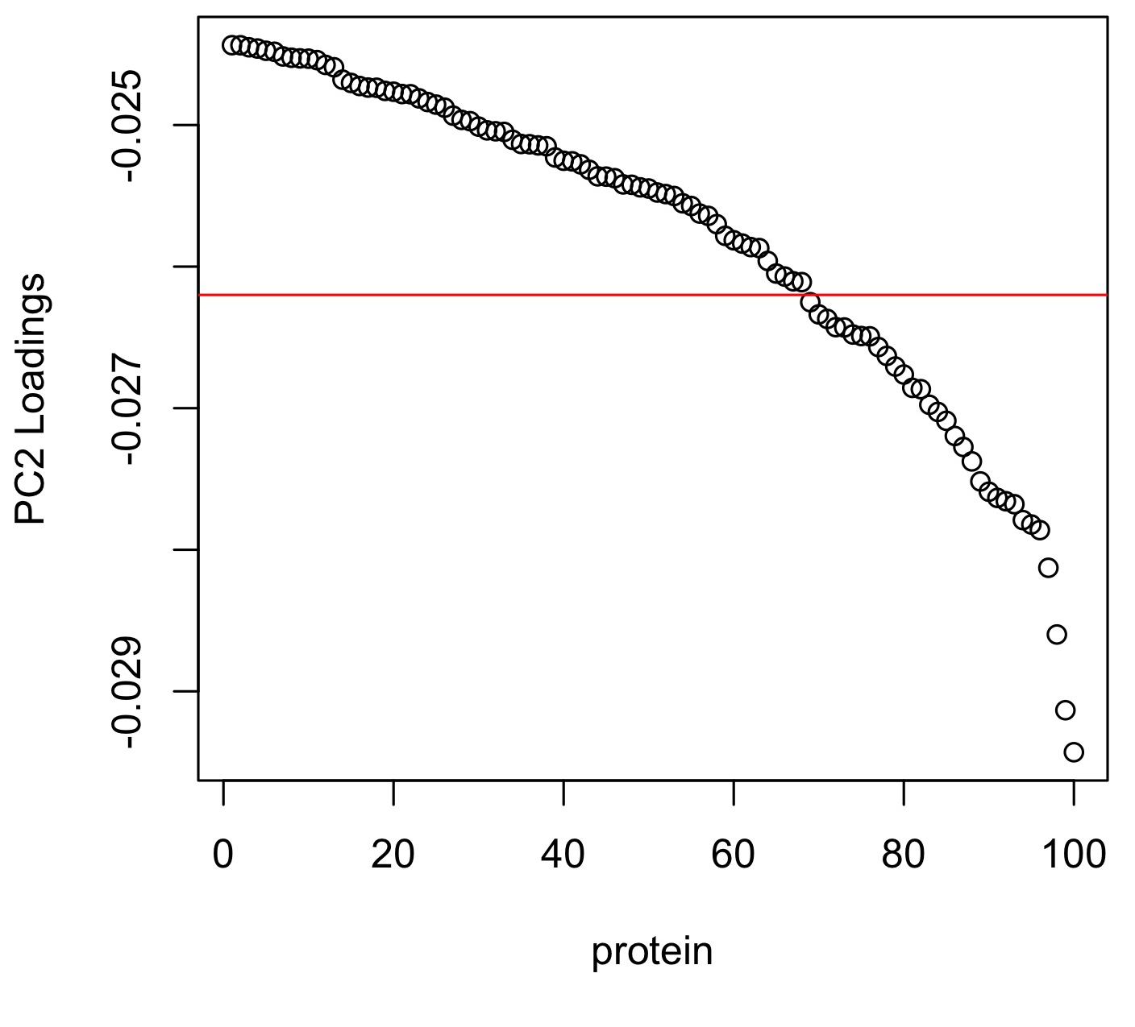
A
B
C
D

